Slide 1


Empowering Diversity in Swiss Tech
Let’s get connected. Let’s get hired. Let’s get started.
Presented by team Banana Builders
04.11.2023
Zürich
Notes:
Petra
Welcome everyone! Today we’re presenting our platform Bridge, created by team Banana Builders.
Bridge is the platform for empowering diversity in Swiss tech.
So, let’s get connected, let’s get hired, let’s get started!

Slide 2
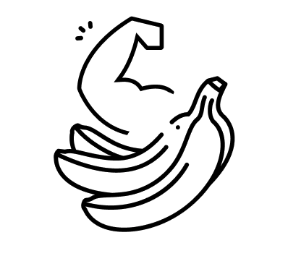

Agenda
Team
Tech jobs in CH
Problems to solve
Focus areas
Demo
Outcome
Team learnings
Q&A
Notes:
Petra
This is the agenda for today’s presentation:
We’ll shortly show who is on our team, talk about the job market for tech in Switzerland, discuss the problems we want to solve with Bridge and what we focused on.
We’ll show you a demo of our platform and what the impact of Bridge is for our users.
Lastly, we’ll show you how we worked together as a team and what we’ve learned before we dive into the time for questions!

Slide 3

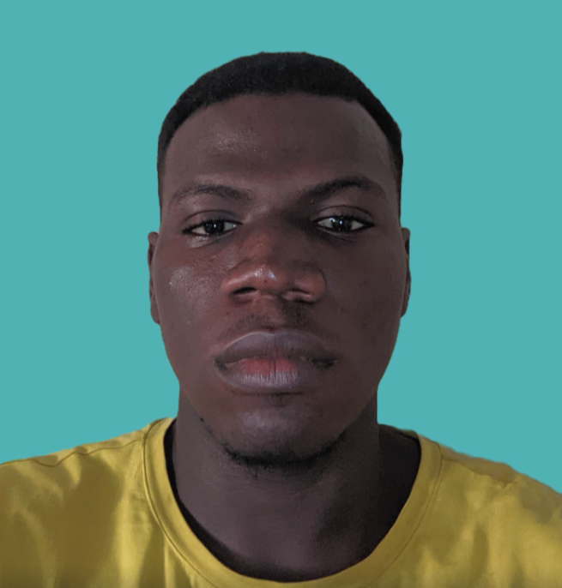
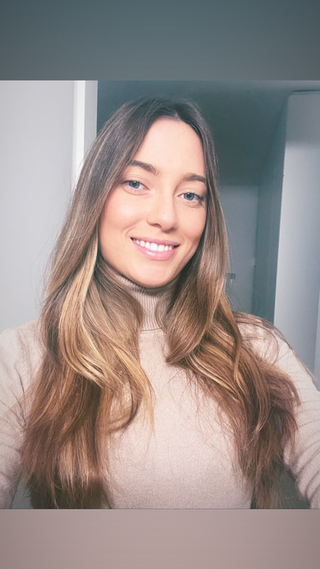

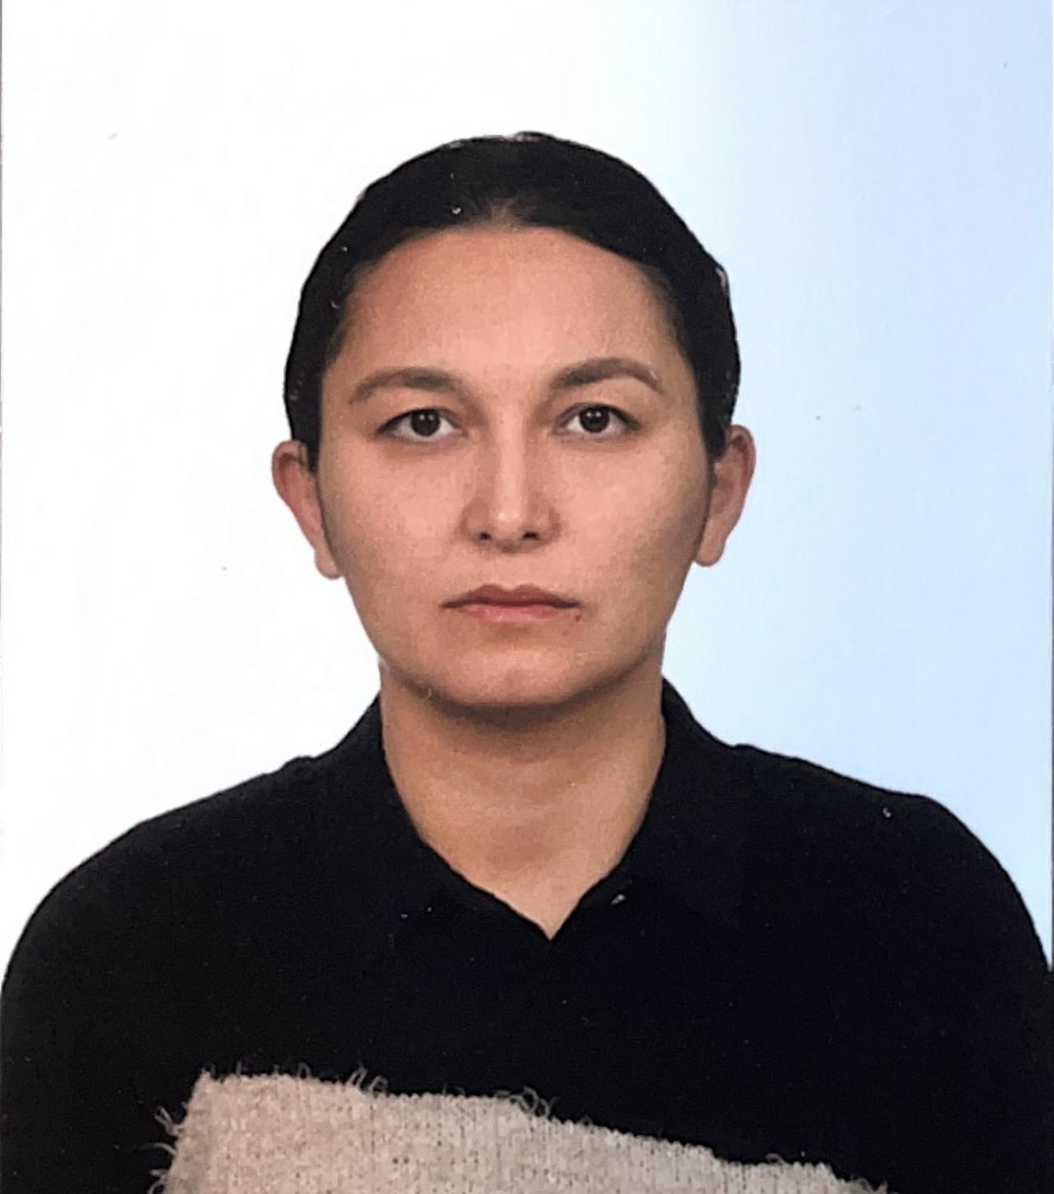

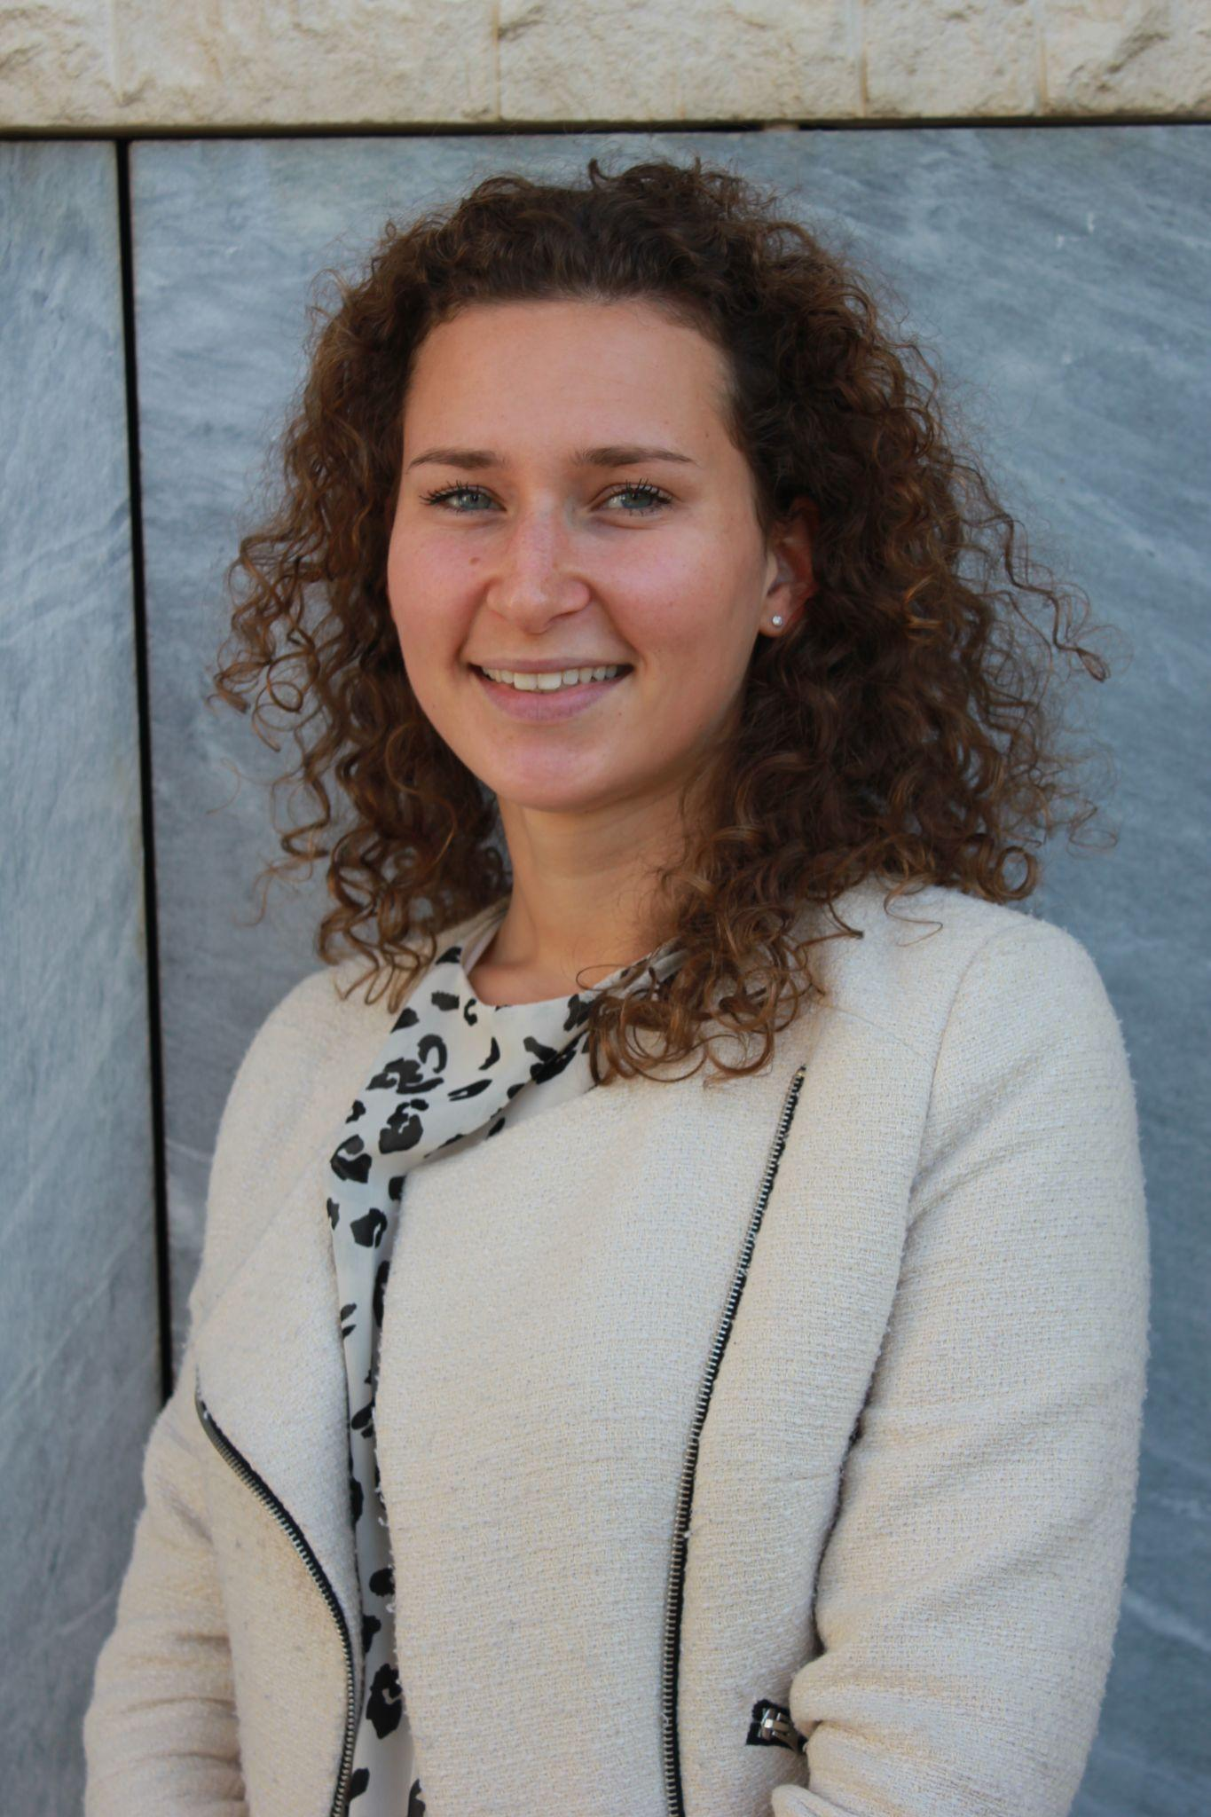
Agenda
Alba Romero Kauss
Full Stack Engineer
Isaac Omolayo
Data Science
Team
Tech jobs in CH
Problems to solve
Focus areas
Demo
Outcome
Team learnings
Q&A
Laura Purcaro
Full Stack Engineer
Maria Reis
UI/UX design
Meytap Yildiz
Full Stack Engineer
Noor Halta
Scrum Master
Petra Slits
Project Manager
Notes:
Petra
I proudly present you team Banana Builders!
We have Alba, Laura and Meytap, our engineering team and they’re all here.
We have Maria, our designer, also here.
Isaac, on data science and Noor, the scrum master are joining us online.
And my name is Petra, and I’m the PM

Slide 4


Agenda
Team
Tech jobs in CH
Problems to solve
Focus areas
Demo
Outcome
Team learnings
Q&A
Notes:
Petra
Let me explain you the context we’re working in.

Slide 5

Tech jobs in Switzerland
Companies increasingly reliant on tech
Diversity targets based on gender
Applicants from all around the world
German or French language often required
Complexity obtaining visa for outside EU
Fighting bias
Nonprofits trying to close the gap
Offering skill building and networks
Notes:
Petra
Our platform is tailored towards the tech job market in Switzerland; some companies represented by the fruit baskets here on the slide. They have tech teams based on apples, pears and bananas.
Like any other country in the world, the Swiss companies are more and more becoming reliant on tech teams.
Another thing becoming more important for companies, is that they have diversity targets because companies realise results tend to increase the more diversity. These targets are currently mostly gender based.
To fill up the many positions, there are a lot of applicants from all across the world, because Switzerland is pretty cool country to live.
Unfortunately, these applicants are facing some difficulties getting jobs in Swiss companies
First of all, they often don’t speak one of the local languages that are often required for the jobs
Second, it might be quite difficult to get a visa if you’re from outside the EU
And lastly, they are fighting with bias in the recruitment process.
On the other hand, one good thing going for applicants, are non profit organisation such as Women++ and Powercoders who are trying to close the gaps on tech diversity by offering training and networks, yet they are also missing the true connection to the job market.
Fruit Basket by Siipkan Creative from <a href="https://thenounproject.com/browse/icons/term/fruit-basket/" target="_blank" title="Fruit Basket Icons">Noun Project</a> (CC BY 3.0)
grapes by Llisole from <a href="https://thenounproject.com/browse/icons/term/grapes/" target="_blank" title="grapes Icons">Noun Project</a> (CC BY 3.0)
Pineapple by Alina Oleynik from <a href="https://thenounproject.com/browse/icons/term/pineapple/" target="_blank" title="Pineapple Icons">Noun Project</a> (CC BY 3.0)
Melon by Mohamed Mb from <a href="https://thenounproject.com/browse/icons/term/melon/" target="_blank" title="Melon Icons">Noun Project</a> (CC BY 3.0)

Slide 6


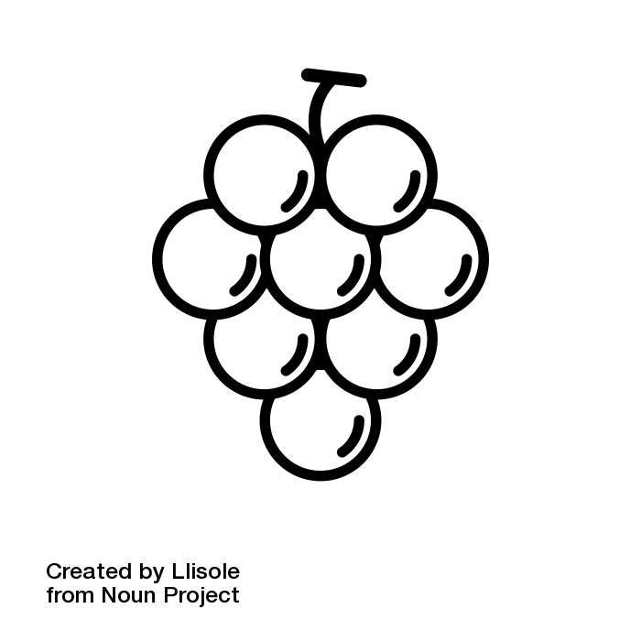
Tech jobs in CH
So where do these outsiders fit in?
Notes:
Petra
So where do you go if you’re not one of the standard fruits? What happens to outsiders like the melons, pineapples and grapes? In which fruit basket will they fit?
Fruit Basket by Siipkan Creative from <a href="https://thenounproject.com/browse/icons/term/fruit-basket/" target="_blank" title="Fruit Basket Icons">Noun Project</a> (CC BY 3.0)
grapes by Llisole from <a href="https://thenounproject.com/browse/icons/term/grapes/" target="_blank" title="grapes Icons">Noun Project</a> (CC BY 3.0)
Pineapple by Alina Oleynik from <a href="https://thenounproject.com/browse/icons/term/pineapple/" target="_blank" title="Pineapple Icons">Noun Project</a> (CC BY 3.0)
Melon by Mohamed Mb from <a href="https://thenounproject.com/browse/icons/term/melon/" target="_blank" title="Melon Icons">Noun Project</a> (CC BY 3.0)

Slide 7

Agenda
Team
Tech jobs in CH
Problems to solve
Focus areas
Demo
Outcome
Team learnings
Q&A
Notes:
Petra
As this picture describes, we can highlight many problems in the job market. Let’s look at the most important ones.

Slide 8
Problems to solve
Recruiters
Difficulty finding right talent
Skills hard to assess
Candidates
Fighting bias
Lacking experience in tech
Associations
Impact gap
Notes:
Petra
First of all, for recruiters it is hard to find the right talent through the many applications they receive.
It’s hard to assess the skills of candidates because education is different everywhere and especially tech bootcamps are a new promising educational type that might differ greatly in quality.
For candidates on the other hand, it is really hard to make their profile noticed to recruiters because it’s a competitive market
Next to that, they’re fighting biases when they apply with their full names, pictures, and other personal information
Also, thanks to bootcamps they might have the skills required, but are lacking in work experience in tech, even if they’ve had a lot of work experience in another industry.
Lastly, for the non profit associations supporting candidates and companies, they might be providing networking and skills, but have a big gap on impact when it comes to real connections to jobs and recruiters.
Fruit Basket by Siipkan Creative from <a href="https://thenounproject.com/browse/icons/term/fruit-basket/" target="_blank" title="Fruit Basket Icons">Noun Project</a> (CC BY 3.0)
grapes by Llisole from <a href="https://thenounproject.com/browse/icons/term/grapes/" target="_blank" title="grapes Icons">Noun Project</a> (CC BY 3.0)
Pineapple by Alina Oleynik from <a href="https://thenounproject.com/browse/icons/term/pineapple/" target="_blank" title="Pineapple Icons">Noun Project</a> (CC BY 3.0)
Melon by Mohamed Mb from <a href="https://thenounproject.com/browse/icons/term/melon/" target="_blank" title="Melon Icons">Noun Project</a> (CC BY 3.0)

Slide 9

Agenda
Team
Tech jobs in CH
Problems to solve
Focus areas
Demo
Outcome
Team learnings
Q&A
Notes:
Maria
We decided there are some areas of these problems that we like to focus on the most with our platform, let’s dive into that

Slide 10
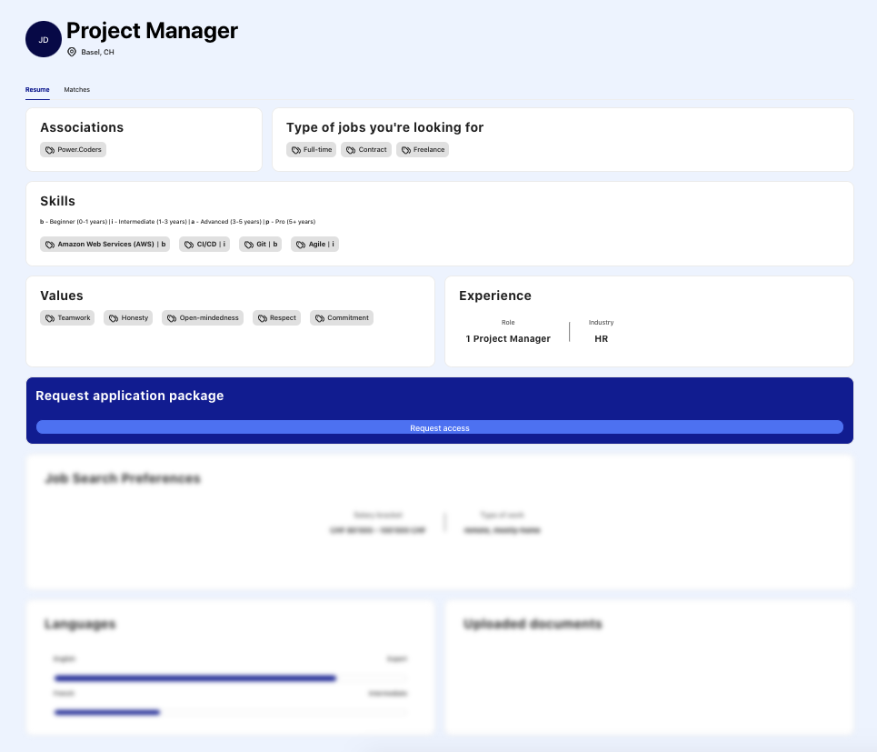
Unbiased recruiting
Anonymized profile
Focus on skills and values
Application package
Notes:
Maria
First of all, we want to address the bias in recruiting.
It is widely known that names, age or nationality can infer specific benefits or disadvantages when it comes to recruiting. That’s why we removed them all from our public candidate profile on Bridge. Recruiters can see initials and the preferred location of work.
The profiles on our platform focus a lot on skills, both hard and soft skills, where candidates can also rate their hard skill level.
Next to that, we actually emphasize on the values of the candidate and the company, so this is visible for the recruiter at first glance.
We’ve built a platform where the candidate can decide what is on their public profile and what they want to send to recruiters as their application package. This can be send on request of the recruiter or when the candidate has an interest in a job.
In the application package, way more personal information can be found, such as language, recruitment preferences like salary and notice period, industry experience, certificates, the CV and most importantly contact information.
Hiding personal information from the public profile makes that the very first step in recruitment will be already less biased than normally
→ hide information to combate biases - focus on the skills and values

Slide 11




Matching candidates and jobs
Candidate
Hard skills & level
Soft skills
Values
Company
Job description
Skills requirement
Company values
</>
100%
Notes:
Maria
Another really cool feature on our platform, is that we’ll do part of the recruitment / browsing work by adding a matching mechanism!
Candidates will see a score on jobs that suit their skills and recruiters will see candidates that match their jobs on the listings.
The score that is attributed is based on the skills from the candidate, both hard and soft, and the values that they find most important in working culture
These inputs are compared with the text in the job description, the extra specified skills and the company values.
All of this input together leads to a total score that shows how well we would expect the candidates would do for the jobs.
→ based on that information we can match candidates and job descriptions, including the values
Couple by Andrejs Kirma from <a href="https://thenounproject.com/browse/icons/term/couple/" target="_blank" title="Couple Icons">Noun Project</a> (CC BY 3.0)
Strawberry by Lyhn from <a href="https://thenounproject.com/browse/icons/term/strawberry/" target="_blank" title="Strawberry Icons">Noun Project</a> (CC BY 3.0)

Slide 12
Agenda
Team
Tech jobs in CH
Problems to solve
Focus areas
Demo
Outcome
Team learnings
Q&A
Notes:
Maria
Keeping these features in mind, let’s have a look at the demo of Bridge

Slide 13
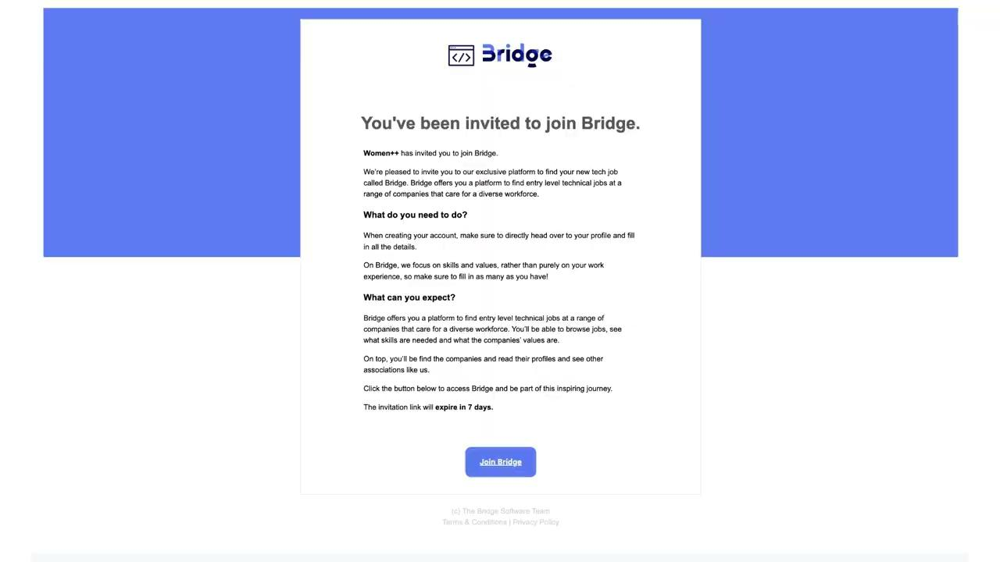
Bridge demo
Link to demo
Notes:
DEMO

Slide 14
Agenda
Team
Tech jobs in CH
Problems to solve
Focus areas
Demo
Outcome
Team learnings
Q&A
Notes:
Meytap
After showing you what Bridge looks like and how it works, I’d like to highlight some of the most important outcomes for the main users of the platform.

Slide 15

Companies
Candidates
Associations
Quality candidates
Match on skills
Offer next step
Matching helps sourcing
Unbiased recruiting
Measure impact
Notes:
Meytap
With Bridge, we wanted to create a win-win-win situation for all the users involved,
For the companies and recruiters, they will have a place to upload their job listings, and in return they get a curated pool of high quality candidates from which only limited companies can pick!
For candidates, they fill up the platform with their skills, forming the talent pool and from there they can enjoy the benefits of less biased recruiting and direct access to recruiters from companies that they might be interested in
For the non profit associations, they are able to really offer the next step, both for their participants and companies they work with. They also finally have a place where they can measure their impact based on the number of candidates, companies and jobs on the platform

Slide 16
Agenda
Team
Tech jobs in CH
Problems to solve
Focus areas
Demo
Outcome
Team learnings
Q&A
Notes:
Petra
Thanks Meytap and the rest of the team for helping me present the amazing work we’ve done over the last weeks.
All of this work, lead to a lot of learnings for us.

Slide 17
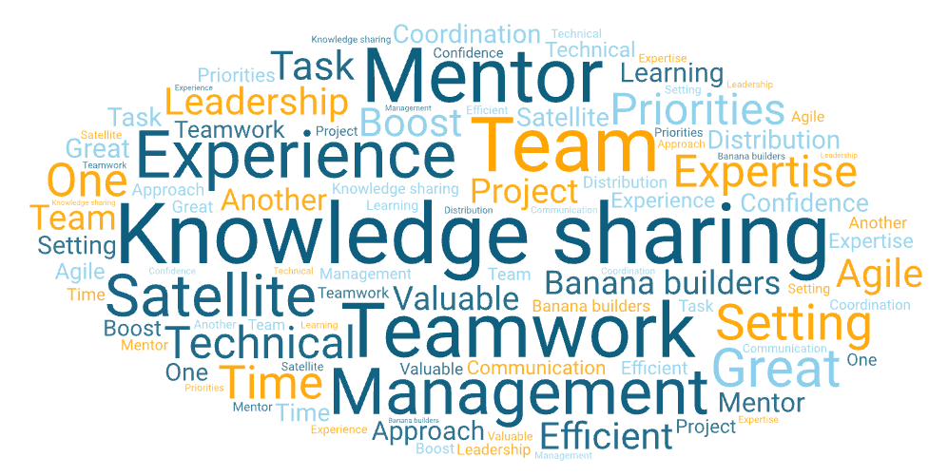
Learnings
Notes:
Petra
We decided that a picture is worth more than 1000 words, so we used a lot of our words to create this image.
It represents all our learnings together as a team.
We’ve shared an intense 6 weeks where we all collaborated smoothly, and we’re very proud of our end result.
It has been a true team effort where everyone contributed and we had fun on the way!

Slide 18
Agenda
Team
Tech jobs in CH
Problems to solve
Focus areas
Demo
Outcome
Team learnings
Q&A
Notes:
Petra
All right, it’s not over until it’s over.
Let’s move the questions!

Slide 19








Thanks! Any questions?
CH visa ✔
Alba Romero Kauss
Full Stack Engineer
Open to opportunities
Isaac Omolayo
Data Science
Looking for a job
CH visa ✔
Laura Purcaro
Full Stack Engineer
Open to opportunities
Maria Reis
UI/UX design
CH visa ✔
Looking for a job
CH visa ✔
Meytap Yildiz
Full Stack Engineer
Looking for a job
Noor Halta
Scrum Master
CH visa ✔
Looking for a job
EU visa ✔
Petra Slits
Project Manager
Team Banana Builders
Looking for a job
Special thanks to our mentor Philipp Lichtenberg for his valuable insights and our team satellite Claudia Annoni for supporting us with the delivery of the project.

Slide 20
Appendix
Roadmap
Matching algorithm

Slide 21

Roadmap
M1
M2
M3
Companies
Notifications back end
Multiple users
Best practices
Saved filter sets
Saved comments
Candidates
Notifications back end
Opening files on profile
Saved filter sets
Associations
Notifications back end
Multiple users
Reporting
Admin
Reporting
Account management
Matching
Weights and thresholds tests
Adjustments
Testing
Adding criteria
More details in our user stories and prioritization document.

Slide 22

Matching algorithm
Job and candidates are matched based on
Hard skills & level (weight 7)
Soft skills (weight 2)
Values (weight 1)
There are 4 hard skills levels (Beginner, Intermediate, Advanced and Pro)
Matching mechanism based on fuzzy keyword algorithm
Algorithm uses TFIDF vectors to compute the similarity between the candidate data and jobs data
Similarity is translated into a percentage score
Candidates with a score above the threshold are matched
Visual representation of our matching mechanism created by AI

